Slide 1
Sulaiman Ali Data Engineer Test Akal Karya

Slide 2
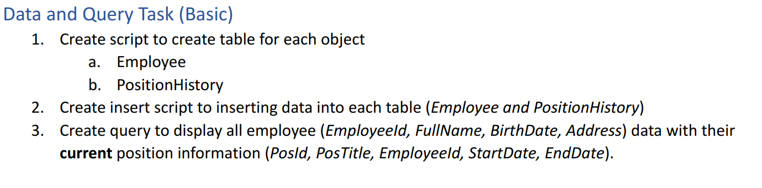

Slide 3
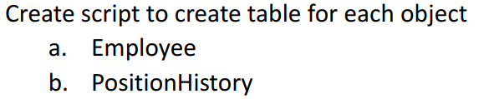
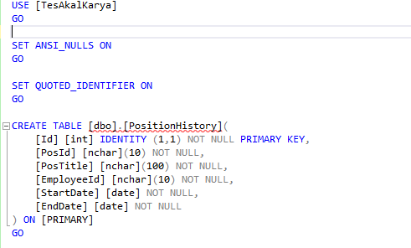
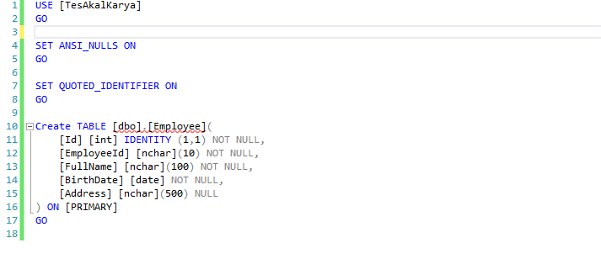
1.

Slide 4
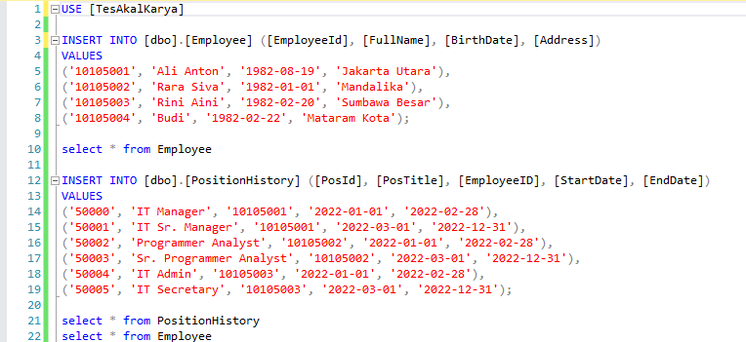
2.

Slide 5
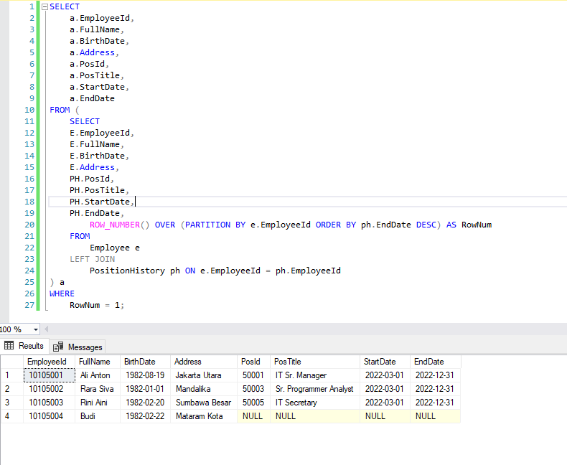
3.

Slide 6
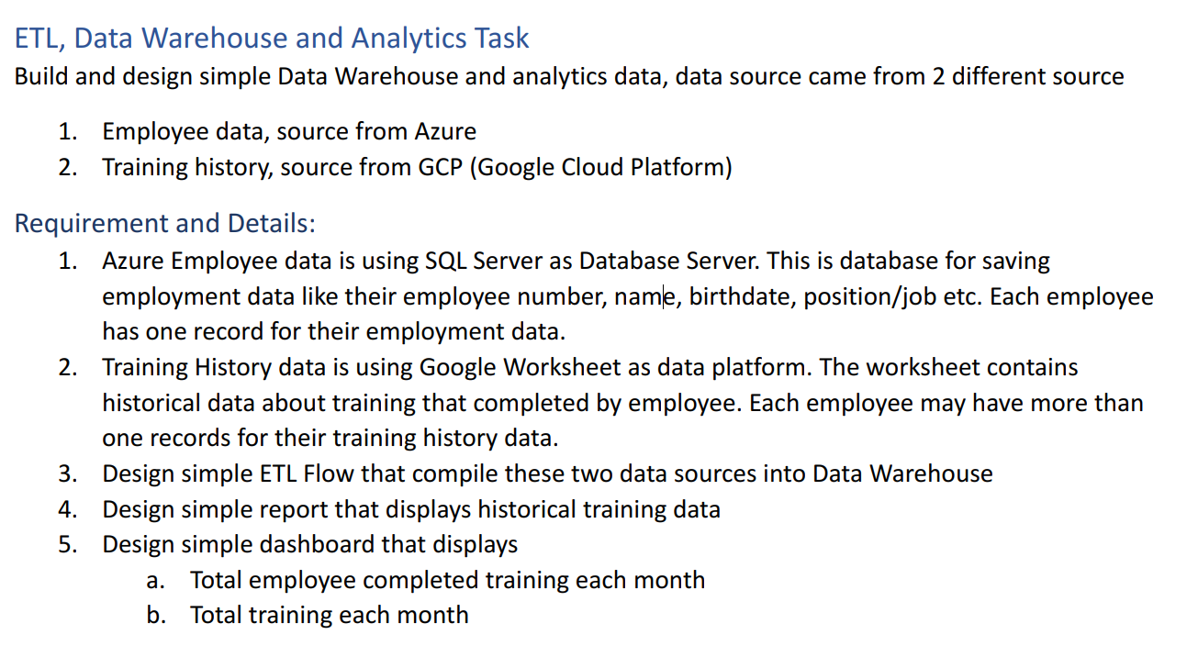

Slide 7









Data Schema
Source Data
Azure
Present
Source Data on Google Platform
Google Sheet
Sql Azure Cloud
Dashboard
Source Data on Premise
Employee
SQL Server (Oreo281)
SSIS
Azure SQL Server (Oreo2811)
Position History

Slide 8
SQL Server Azure
Database Cloud Azure
NAMA SERVER :oreo2811.database.windows.net
USER:oreo2811
PASS:Pa55word@

Slide 9
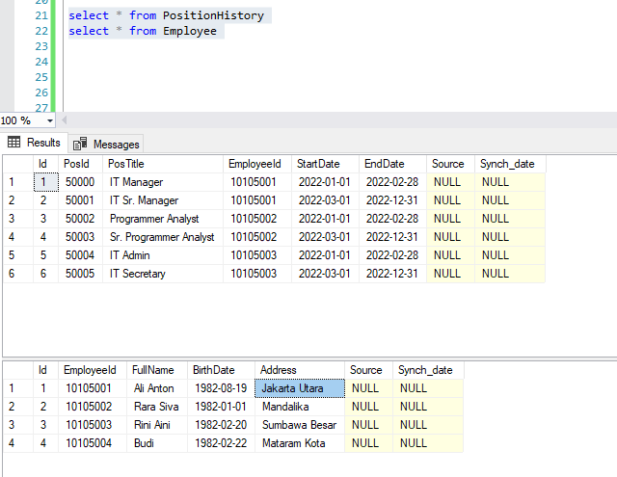
Penambahan Source dan sync_Date untuk proses etl di azure

Slide 10
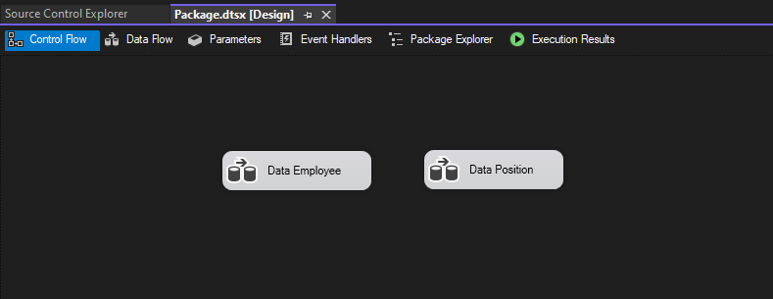
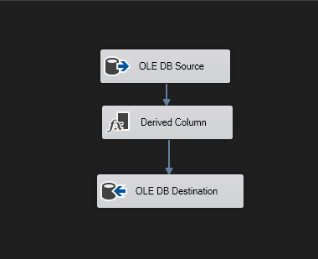
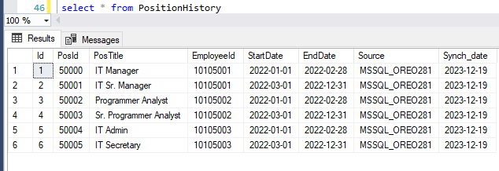
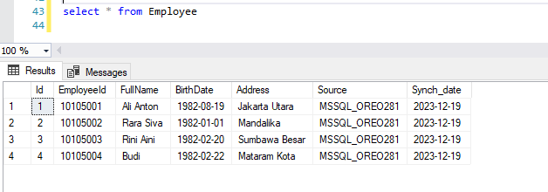
Create ETL SSIS
Data yang telah dilakukan proses etl ke sql azure menggunakan ssis

Slide 11
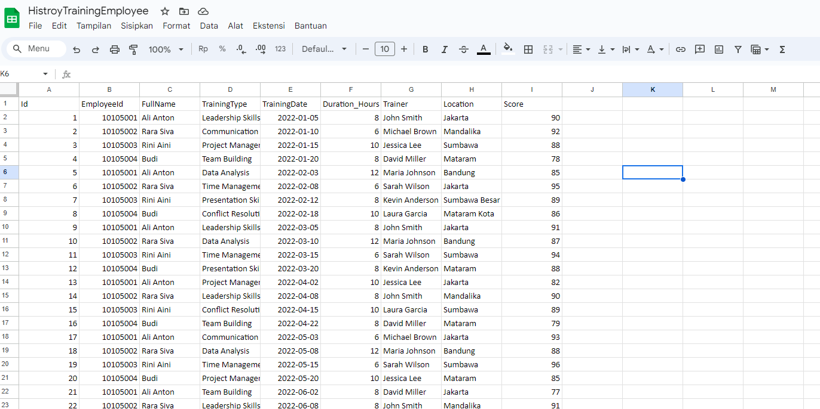
Source from Google Sheet
https://docs.google.com/spreadsheets/d/1Akupq7_J_Cp61tRmJFGYCN54-Id6QptDwPbXXz7CP-I/edit#gid=0

Slide 12
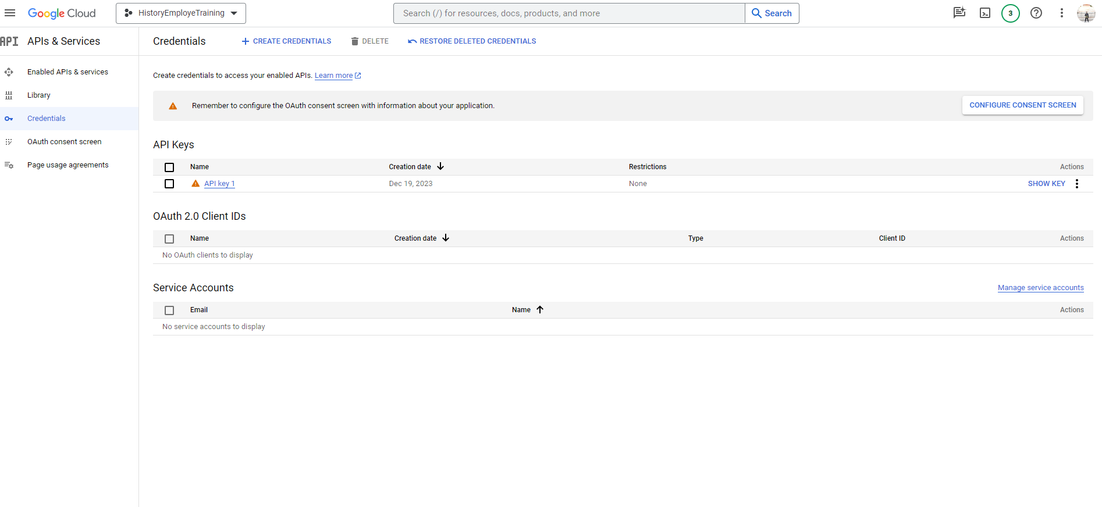
Make Credential to Access Sheet

Slide 13
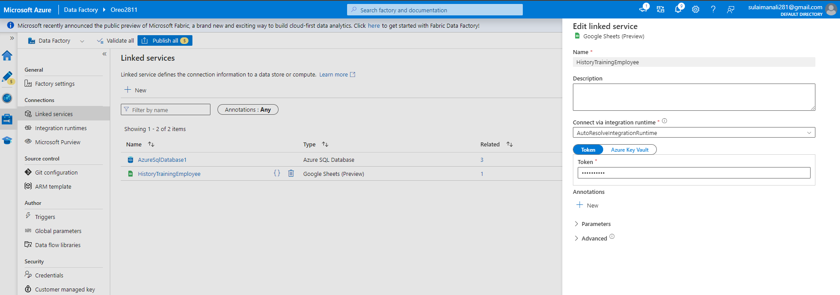
Create Linked Services dari GCP and From AzureSQL Database

Slide 14
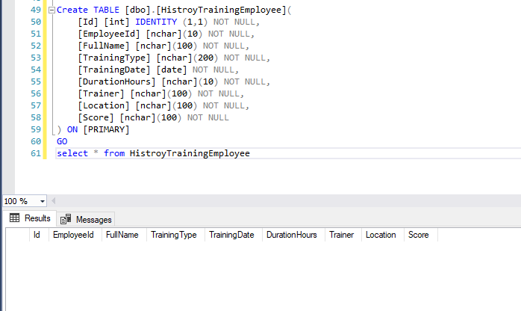
Create Table HistoryTrainingEmployee

Slide 15
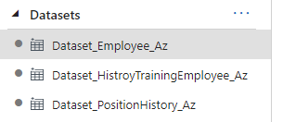
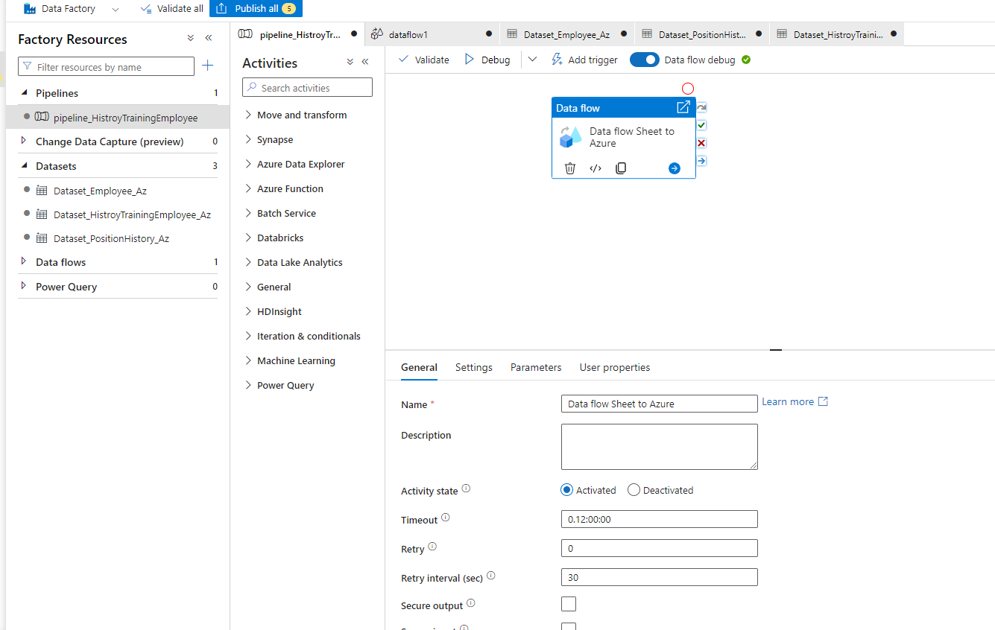
Create dataset
Create pipline to flow data from google sheet to azure dataset

Slide 16
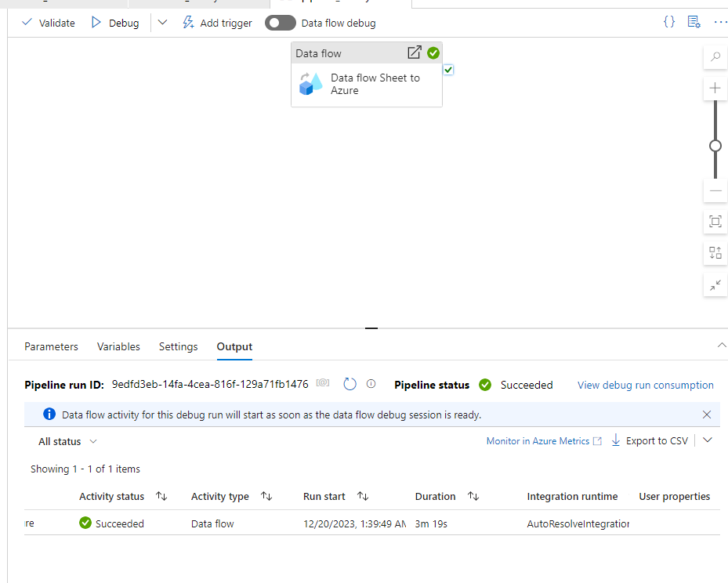
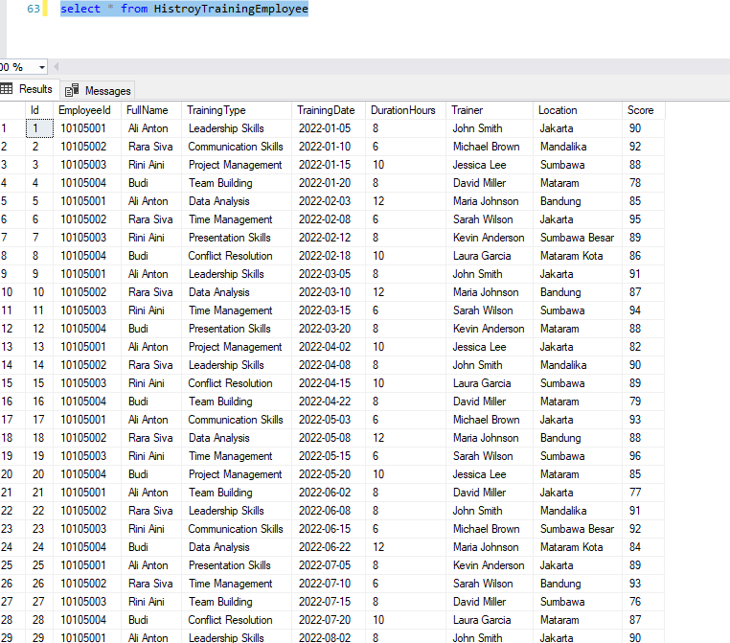
Run Pipeline
Check on Sql Azure

Slide 17
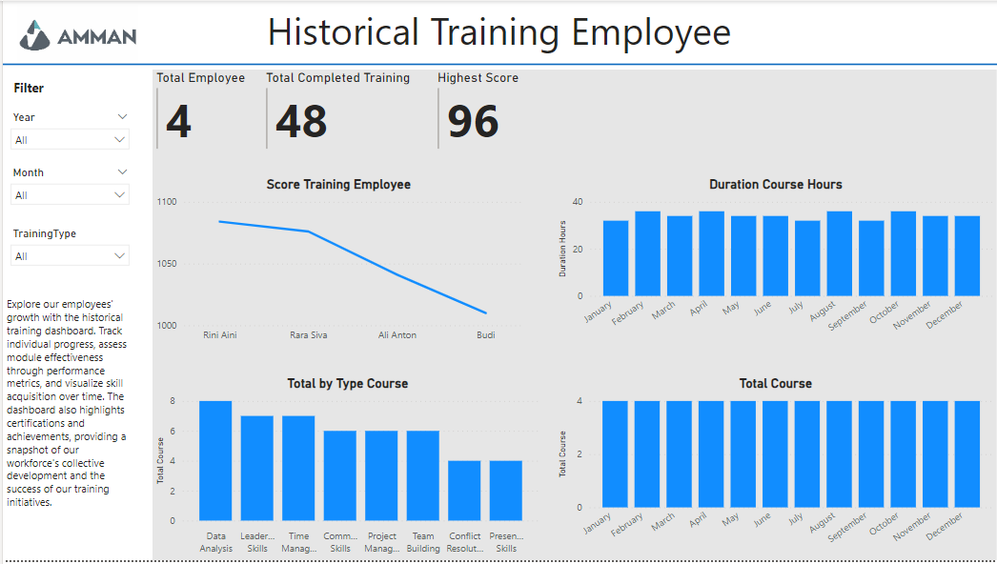
Dashboard Simple with Power BI

